Slide 1

Network Layer: Routing
Computer System Engineering, Fall 2019. (IPADS, SJTU)
All about routing
Yubin Xia

Slide 2
Review: OSI, TCP/IP & Protocol Stack
7th Application Layer
Application Layer
HTTP
SMTP
POP3
FTP
…
End-to-end Layer
6th Presentation Layer
5th Session Layer
4th Transport Layer
Transport Layer
TCP
UDP
3th Network Layer
Network Layer
IP
Network Layer
ICMP
2nd Link Layer
Link Layer
ARP & RARP
Ethernet
PPP
…
Link Layer
1st Physical Layer
WiFi
Fiber
TD-LTE
FDD
…
OSI
TCP/IP
CSE

Slide 3


Src IP: 192.168.1.2
Src IP: 202.120.40.85
Dst IP: 173.194.72.104
Dst IP: 173.194.72.104
Src Port: 54321
Src Port: 60001
Dst Port: 80
Dst Port: 80
Data
Data
Netgate
192.168.1.2
192.168.1.1
202.120.40.85
173.194.72.104
Src IP: 173.194.72.104
Src IP | Src Port | NAT Port
192.168.1.2 | 54321 | 60001
192.168.1.2 | 12345 | 60002
...
Src IP: 173.194.72.104
Dst IP: 192.168.1.2
Dst IP: 202.120.40.85
Src Port: 80
Src Port: 80
Dst Port: 54321
Dst Port: 60001
Data
Data

Slide 4
CASE: Ethernet Mapping
Mapping Internet to Ethernet

Slide 5
Case Study: Mapping Internet to Ethernet
Listen-before-sending rule, collision
Ethernet: CSMA/CD
  Carrier Sense Multiple Access with Collision Detection
Ethernet type
  Experimental Ethernet, 3 mpbs
  Standard Ethernet, 10 mbps
  Fast Ethernet, 100 mbps
  Gigabit Ethernet, 1000 mbps
Notes:
基带冲突检测的载波监听多路访问技术(载波监听多点接入/碰撞检测)

Slide 6
Overview of Ethernet
A half duplex Ethernet
  The max propagation time is less than the 576 bit times, the shortest allowable packet
  So that two parties can detect a collision together
  If collision: wait random first time, exponential backoff if repeat
A full duplex & point-to-point Ethernet
  No collisions & the max length of the link is determined by the physical medium

Slide 7
Difference between Hub and Switch
Hub
  A frame is "broadcast" to every one of its ports
  A 10/100Mbps hub must share its bandwidth with each port
Switch
  Keeps a record of the MAC addresses of all the devices
  A 10/100Mbps switch will allocate a full 10/100Mbps to each of its ports

Slide 8
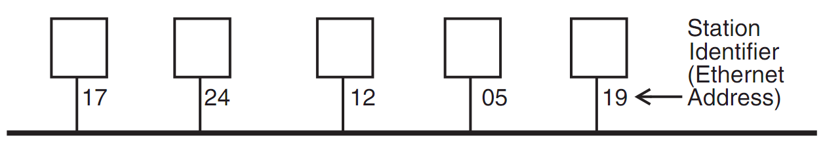
Broadcast Aspects of Ethernet
Broadcast network
  Every frame is delivered to every station
  (Compare with forwarding network)
ETHERNET_SEND
  Pass the call along to the link layer
ETHERNET_HANDLE
  Simple, can even be implemented in hardware

Slide 9
Broadcast Aspects of Ethernet
procedure ETHERNET_HANDLE (net_packet, length)
destination ← net_packet.target_id
if destination = my_station_id
then
GIVE_TO_END_LAYER (net_packet.data,
net_packet.end_protocol,
net_packet.source_id)
else
ignore packet
no need to do any forwarding

Slide 10
Broadcast Aspects of Ethernet
procedure ETHERNET_HANDLE (net_packet, length)
destination ← net_packet.target_id
if destination = my_station_id
or destination = BROADCAST_ID
then
GIVE_TO_END_LAYER (net_packet.data,
net_packet.end_protocol,
net_packet.source_id)
else
ignore packet

Slide 11
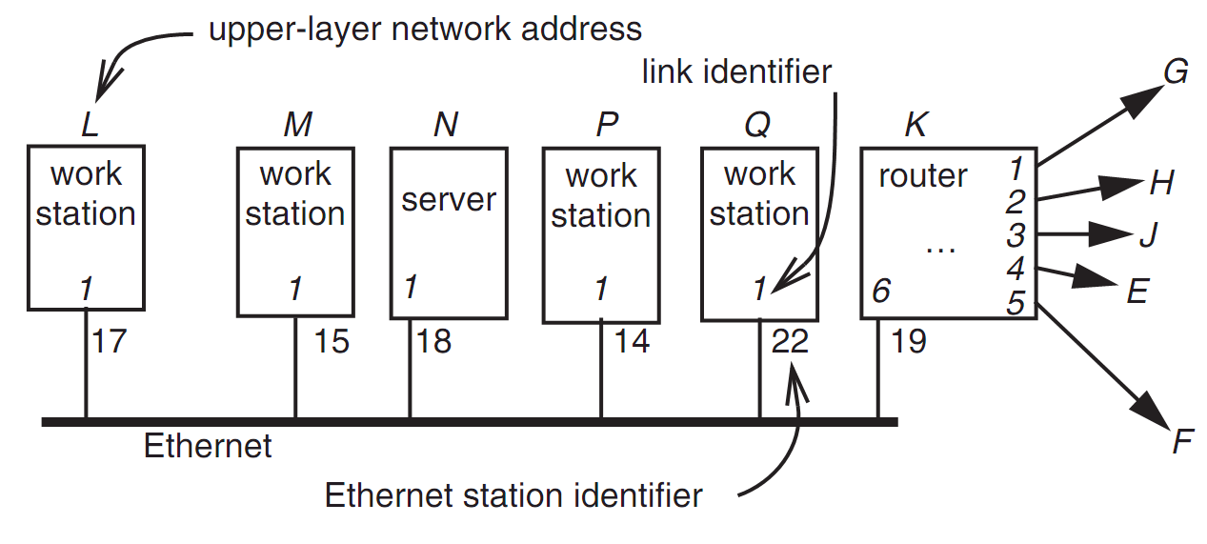
Layer Mapping: Attach Ethernet to Forwarding Network
15
L sends a RPC to N by sending to station 18 of link 1
L sends a RPC to E by sending to K, E may have 15 as address, as well as M

Slide 12
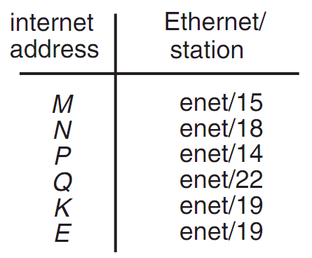
Layer Mapping
The Internet network layer
  NETWORK_SEND (data, length, RPC, INTERNET, N)
  NETWORK_SEND (data, length, RPC, ENET, 18)
L must maintain a table

Slide 13
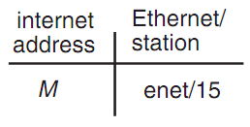
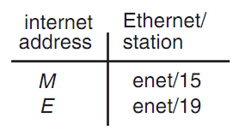
ARP (Address Resolution Protocol)
NETWORK_SEND ("where is M?", 11, ARP, ENET, BROADCAST)
NETWORK_SEND ("M is at station 15", 18, ARP, ENET, BROADCAST)
L asks E's Ethernet address, E does not hear the Ethernet broadcast, but the router at station 19 does, and it sends a suitable ARP response instead
Manage forwarding table as a cache

Slide 14
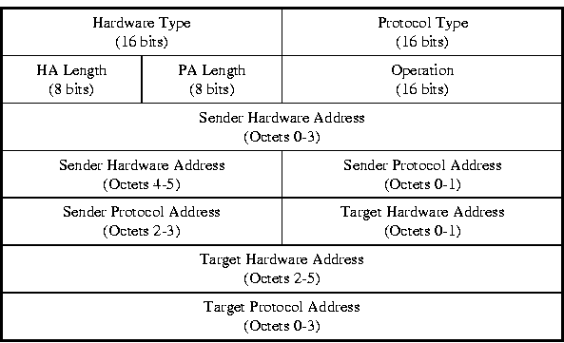
ARP & RARP Protocol
Name mapping: IP address <-> MAC address

Slide 15
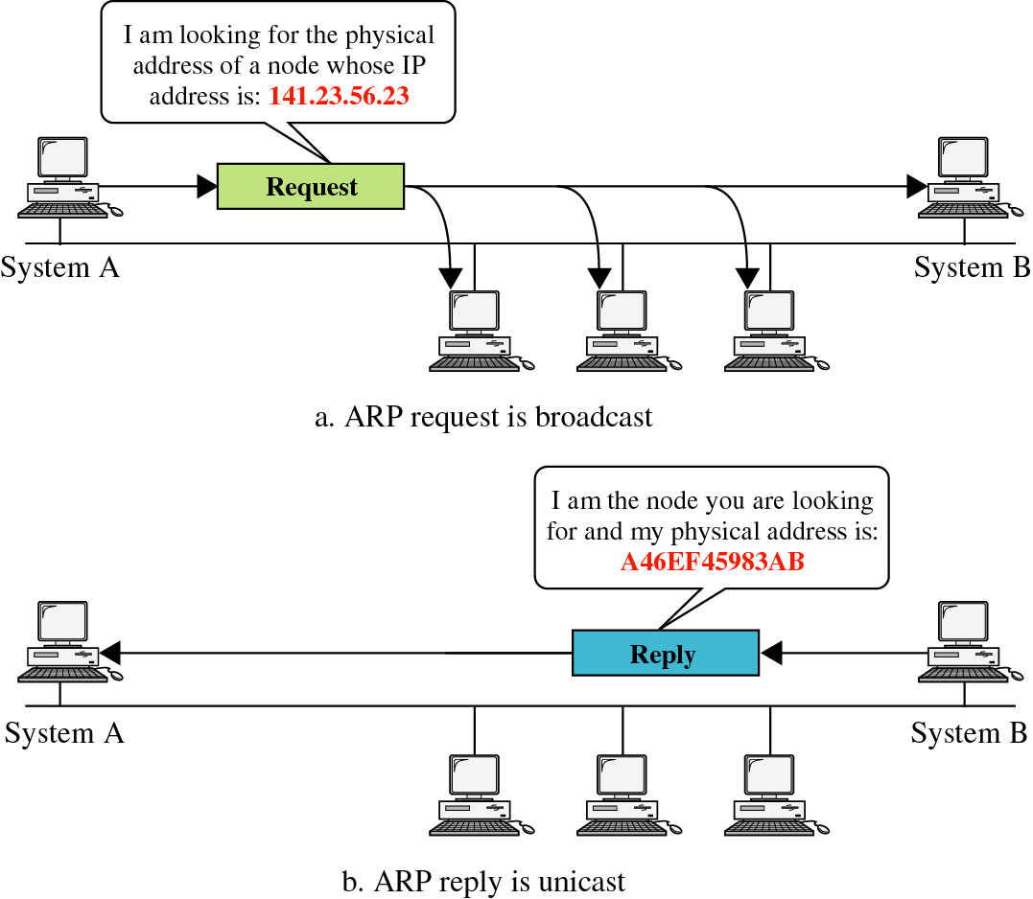
ARP &
RARP

Slide 16
Network Topology
Take SJTU network for example
  Subnet: usually like 192.168.0.2 or 10.0.0.2
  Gateway: usually like 192.168.0.1
    Get the global IP address: 202.120.40.82
    A gateway usually has two (or more) IP address
  Proxy: get proxy's address
    E.g., 106.185.46.164 (Japan)

Slide 17
Network Topology
Baidu
192.168.0.2
A
192.168.0.3
B
220.181.57.217
G
Google
192.168.0.4
C
Gateway
Proxy
192.168.0.1
    202.120.40.82
106.185.46.164
173.194.38.198

Slide 18
How to Use socket to Access www.baidu.com ?
You code as if your PC connect directly with Baidu
  Call connect() with Baidu's IP address
But how does the system find next hop?
C
Baidu
192.168.0.4
220.181.57.217

Slide 19
Putting All Together
App: I want to send a packet to Baidu, here is the packet with Baidu's IP in its header as target IP, and client's IP as source IP (Node-C)
OS: I don't know how to get to Baidu, I'll just send it to the router (gateway). But I cannot change the source IP of the packet, so I'll just change the MAC target address of the packet to the router's MAC address
Target MAC:
Source MAC:
Target IP: Baidu's IP
Source IP: Node-C
Data
Target MAC: Gateway
Source MAC: Node-C
Target IP: Baidu's IP
Source IP: Node-C
Data

Slide 20
Putting All Together
Target MAC: Gateway
The router-1 (gateway): I get a packet with my MAC as target address. Is it my IP? No… So I'll just forward it to next hop, by changing the target MAC address to next hop's MAC address (NAT: change source IP and source port as well)
Router-2: I connect directly to Baidu, I'll just change the target MAC address to Baidu
Source MAC: Node-C
Target IP: Baidu's IP
Source IP: Node-C
Data
Target MAC: Router-2
Source MAC: Router-1
Target IP: Baidu's IP
Source IP: Router-1
Data
Target MAC: Baidu
Source MAC: Router-2
Target IP: Baidu's IP
Source IP: Router
Data

Slide 21
ARP Spoofing
Construct spoofed ARP replies
A target computer could be convinced to send frames destined for computer A to instead go to computer B
Computer A will have no idea that this redirection took place
This process of updating a target computer's ARP cache is referred to as "ARP poisoning"

Slide 22
Spoofed ARP reply
IP:10.0.0.2
MAC:cc:cc:cc:cc
Spoofed ARP reply
IP:10.0.0.2
MAC:cc:cc:cc:cc
switch
Spoofed ARP reply
IP:10.0.0.2
MAC:cc:cc:cc:cc
A
IP:10.0.0.1
MAC:aa:aa:aa:aa
B
IP:10.0.0.2
MAC:bb:bb:bb:bb
Hacker
IP:10.0.0.3
MAC:cc:cc:cc:cc
ARP cache
ARP cache
IP | MAC
10.0.0.2 | bb:bb:bb:bb
IP | MAC
10.0.0.1 | aa:aa:aa:aa

Slide 23
switch
A
IP:10.0.0.1
MAC:aa:aa:aa:aa
B
IP:10.0.0.2
MAC:bb:bb:bb:bb
Hacker
IP:10.0.0.3
MAC:cc:cc:cc:cc
A's cache is poisoned
ARP cache
ARP cache
IP | MAC
10.0.0.2 | cc:cc:cc:cc
IP | MAC
10.0.0.1 | aa:aa:aa:aa

Slide 24
ARP Spoofing
Now all the packets that A intends to send to B will go to the hacker's machine
Cache entry would expire, so it needs to be updated by sending the ARP reply again
  How often?
  depends on the particular system
  Usually every 40s should be sufficient
In addition the hacker may not want his Ethernet driver talk too much
  Accomplish with ifconfig -arp

Slide 25
Man-in-the-Middle Attack
A hacker inserts his computer between the communications path of two target computers
The hacker will forward frames between the two target computers so communications are not interrupted
E.g., Hunt, Ettercap, etc.
  Can be obtained easily in many web archives

Slide 26
Man-in-the-Middle Attack
The attack is performed as follows:
  Suppose X is the hacker's computer
  T1 and T2 are the targets
  X poisons the ARP cache of T1 and T2
  T1 associates T2's IP with X's MAC
  T2 associates T1's IP with X's MAC
  All of T1 and T2's traffic will then go to X first, instead of directly to each other

Slide 27
Spoofed ARP reply
IP:10.0.0.2
MAC:cc:cc:cc:cc
Spoofed ARP reply
IP:10.0.0.2
MAC:cc:cc:cc:cc
switch
Spoofed ARP reply
IP:10.0.0.2
MAC:cc:cc:cc:cc
T1
IP:10.0.0.1
MAC:aa:aa:aa:aa
T2
IP:10.0.0.2
MAC:bb:bb:bb:bb
Hacker
IP:10.0.0.3
MAC:cc:cc:cc:cc
ARP cache
ARP cache
IP | MAC
10.0.0.2 | bb:bb:bb:bb
IP | MAC
10.0.0.1 | aa:aa:aa:aa

Slide 28
switch
T1
IP:10.0.0.1
MAC:aa:aa:aa:aa
T2
IP:10.0.0.2
MAC:bb:bb:bb:bb
Hacker
IP:10.0.0.3
MAC:cc:cc:cc:cc
ARP cache
ARP cache
IP | MAC
10.0.0.2 | cc:cc:cc:cc
IP | MAC
10.0.0.1 | aa:aa:aa:aa
T1's cache is poisoned

Slide 29
Forged ARP replies
IP:10.0.0.1
MAC:cc:cc:cc:cc
switch
Forged ARP replies
IP:10.0.0.1
MAC:cc:cc:cc:cc
T1
IP:10.0.0.1
MAC:aa:aa:aa:aa
T2
IP:10.0.0.2
MAC:bb:bb:bb:bb
Hacker
IP:10.0.0.3
MAC:cc:cc:cc:cc
ARP cache
ARP cache
IP | MAC
10.0.0.2 | cc:cc:cc:cc
IP | MAC
10.0.0.1 | aa:aa:aa:aa

Slide 30
switch
T1
IP:10.0.0.1
MAC:aa:aa:aa:aa
T2
IP:10.0.0.2
MAC:bb:bb:bb:bb
Hacker
IP:10.0.0.3
MAC:cc:cc:cc:cc
ARP cache
ARP cache
IP | MAC
10.0.0.2 | cc:cc:cc:cc
IP | MAC
10.0.0.1 | cc:cc:cc:cc
T2's cache is poisoned

Slide 31
Message intended to send to T2
switch
Hacker will
relay the
message
T1
IP:10.0.0.1
MAC:aa:aa:aa:aa
T2
IP:10.0.0.2
MAC:bb:bb:bb:bb
Hacker
IP:10.0.0.3
MAC:cc:cc:cc:cc
ARP cache
ARP cache
IP | MAC
10.0.0.2 | cc:cc:cc:cc
IP | MAC
10.0.0.1 | cc:cc:cc:cc

Slide 32
Hacker will relay the message
switch
Message
intended to
send to T1
T1
IP:10.0.0.1
MAC:aa:aa:aa:aa
T2
IP:10.0.0.2
MAC:bb:bb:bb:bb
Hacker
IP:10.0.0.3
MAC:cc:cc:cc:cc
ARP cache
ARP cache
IP | MAC
10.0.0.2 | cc:cc:cc:cc
IP | MAC
10.0.0.1 | cc:cc:cc:cc

Slide 33
Defenses against ARP Spoofing
No Universal defense (!)
Use static ARP entries
  Cannot be updated
  Spoofed ARP replies are ignored
  ARP table needs a static entry for each machine on the network
  Large overhead
    Deploying these tables
    Keep the table up-to-date

Slide 34
Arpwatch
A free UNIX program which listens for ARP replies on a network
Build a table of IP/MAC associations and store it in a file
When a MAC/IP pair changes (flip-flop), an email is sent to an administrator
Some programs, such as Ettercap, cause only a few flip flops is difficult to be detected on a DHCP-enabled network, where flip flops occur at regular intervals

Slide 35
Routing
How to generate the routing table?

Slide 36
Goal of A Routing Protocol
Allow each switch to know, for every node dst in the network, a route to dst
Allow each switch to know, for every node dst in the network, a minimum-cost route to dst
Build a routing table at each switch, such that routing_table[dst] contains a minimum-cost route to dst

Slide 37
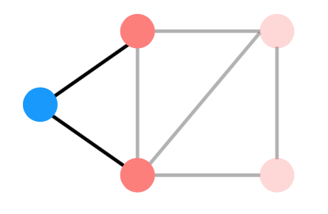
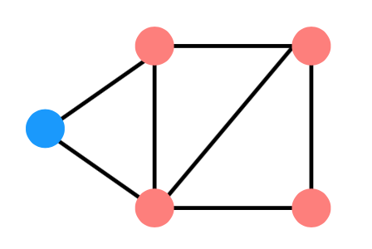
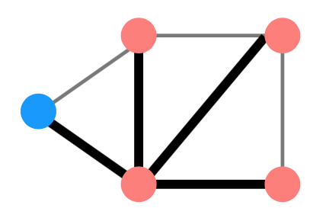
Distributed Routing: 3 Steps in General
Nodes learn about their neighbors via the HELLO protocol
Nodes learn about other reachable nodes via advertisements
Nodes determine the minimum-cost routes (of the routes they know about)

Slide 38
Two Types of Routing Protocol
Protocol 1: Link-state
  Nodes advertise to everyone their costs to their neighbors
    via flooding
  Integrate using Dijkstra's shortest path algorithm
Protocol 2: Distance-vector
  Nodes advertise to neighbors with their cost to all known nodes
  Update routes via Bellman-Ford integration

Slide 39
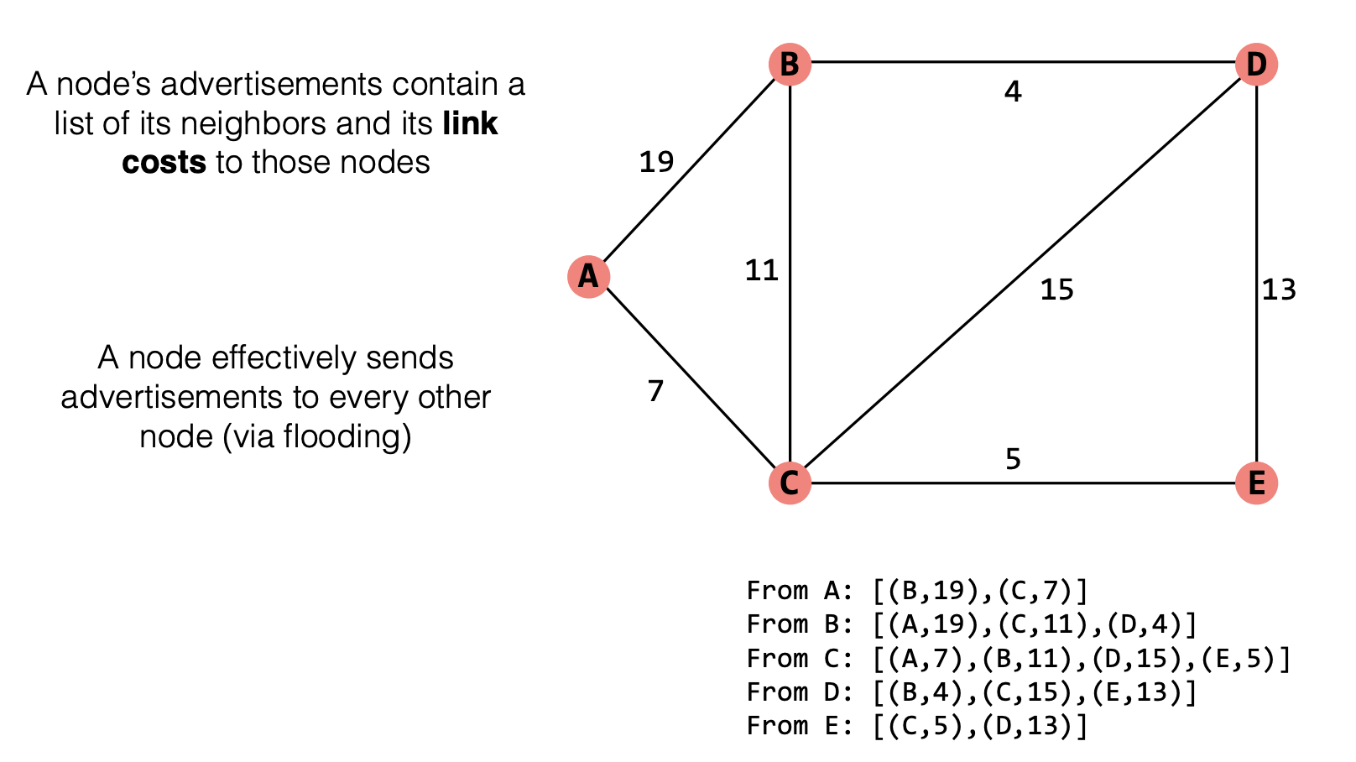
Link-state Routing

Slide 40
Link-state Routing
Keep track of W, the set of nodes haven't processed yet
  Initially, W is all nodes in the network
Keep track of the current costs and routes to all of the nodes. Initially:
  routing_table[self] = Self; routing_table[anyone else] = ?
  cost_table[self] = 0; cost_table[anyone else] = infinity
While W is not empty:
  1. u = the node in W we have the minimum cost to so far
  2. Remove u from W
  3. For every neighbor v of u:
  d = cost_table[u] + cost(u, v)
  if d < cost_table[v]
  cost_table[v] = d
  routing_table[v] = routing_table[u]

Slide 41
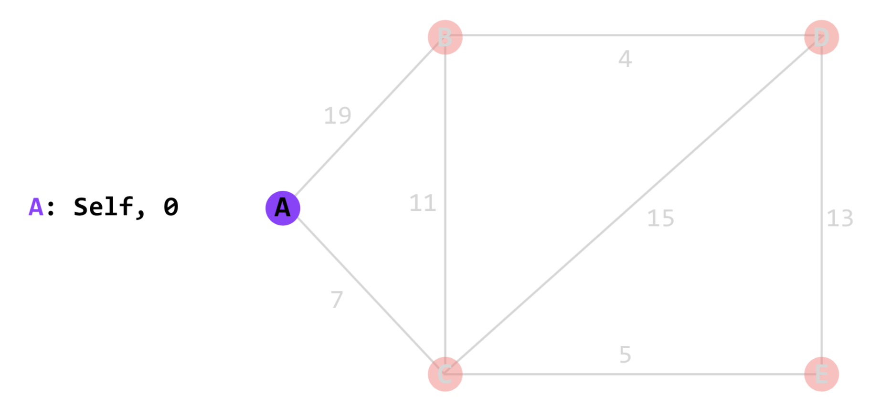
Link-state Routing

Slide 42
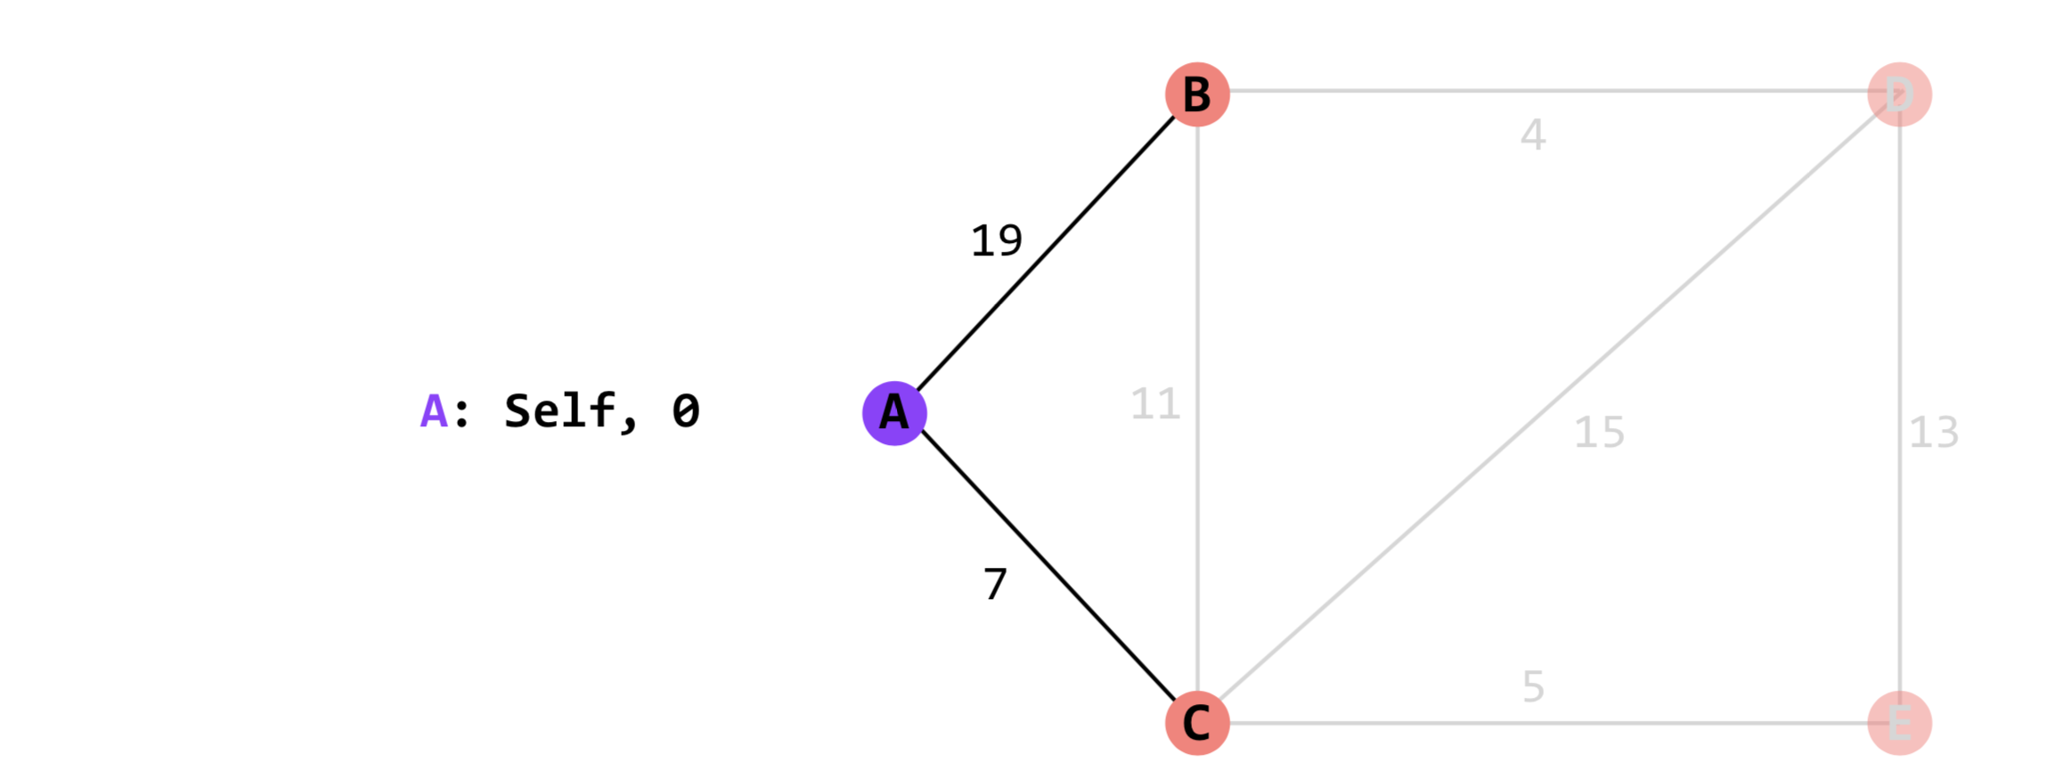
Link-state Routing

Slide 43
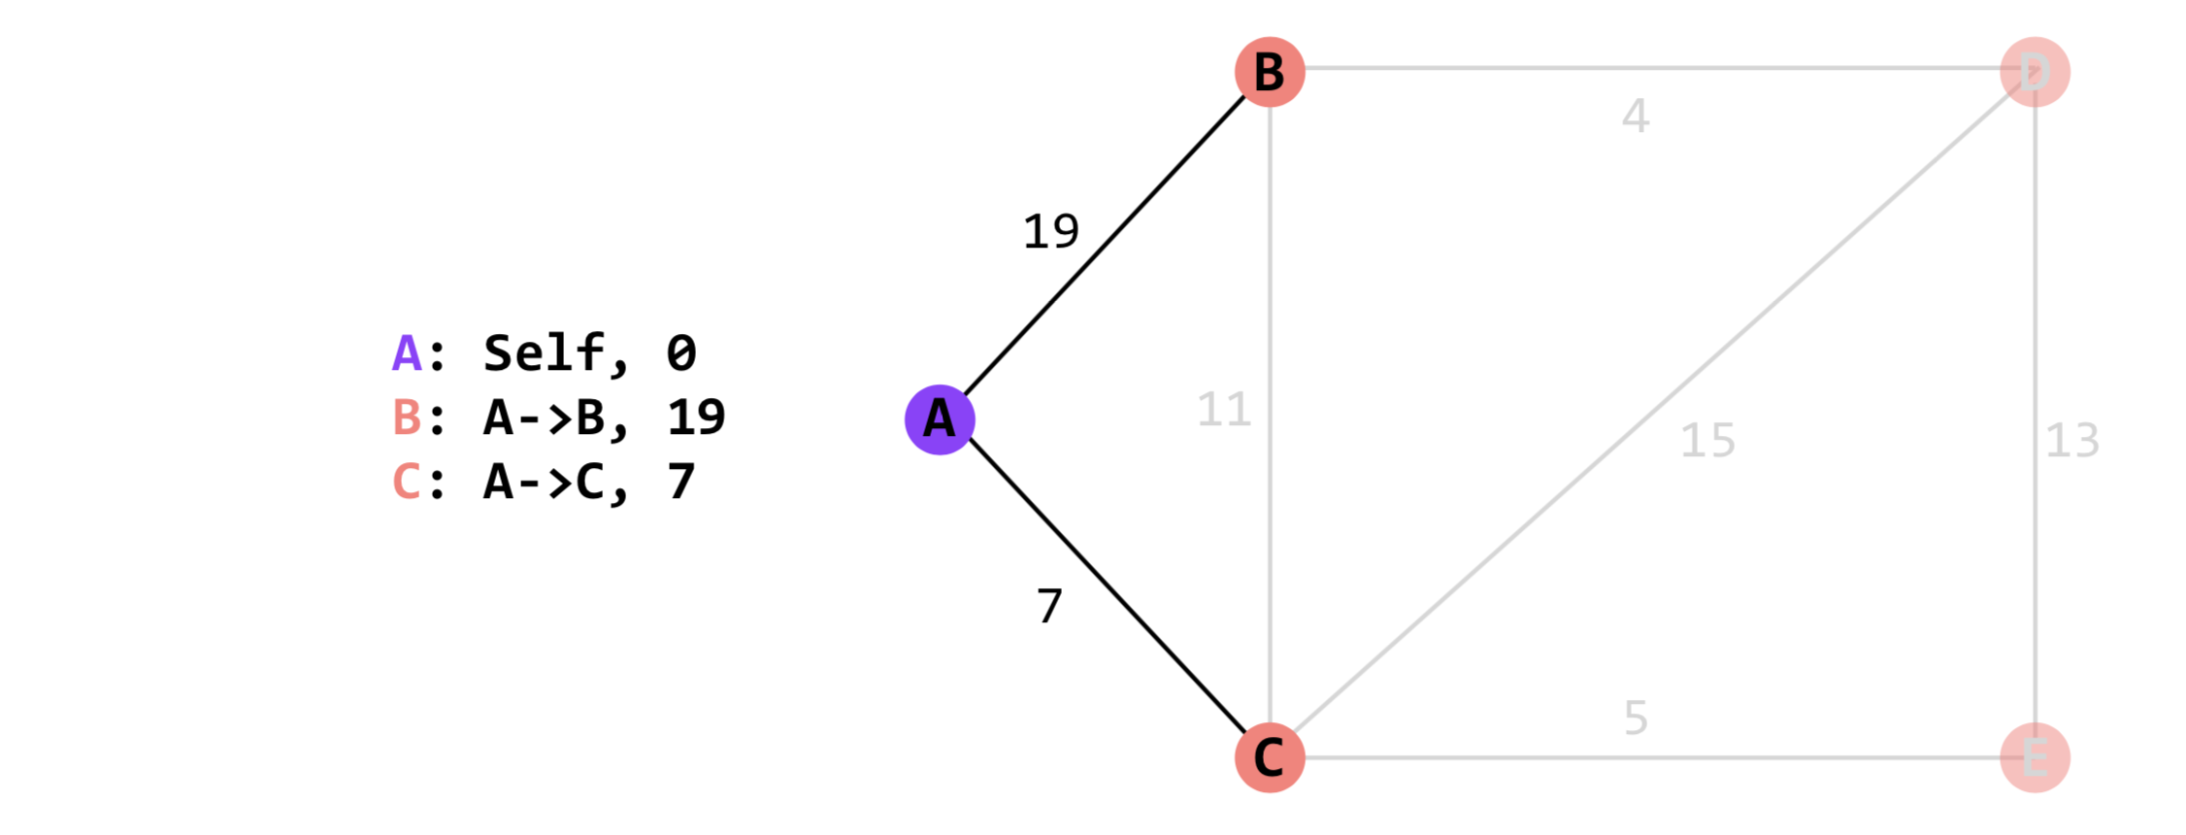
Link-state Routing

Slide 44
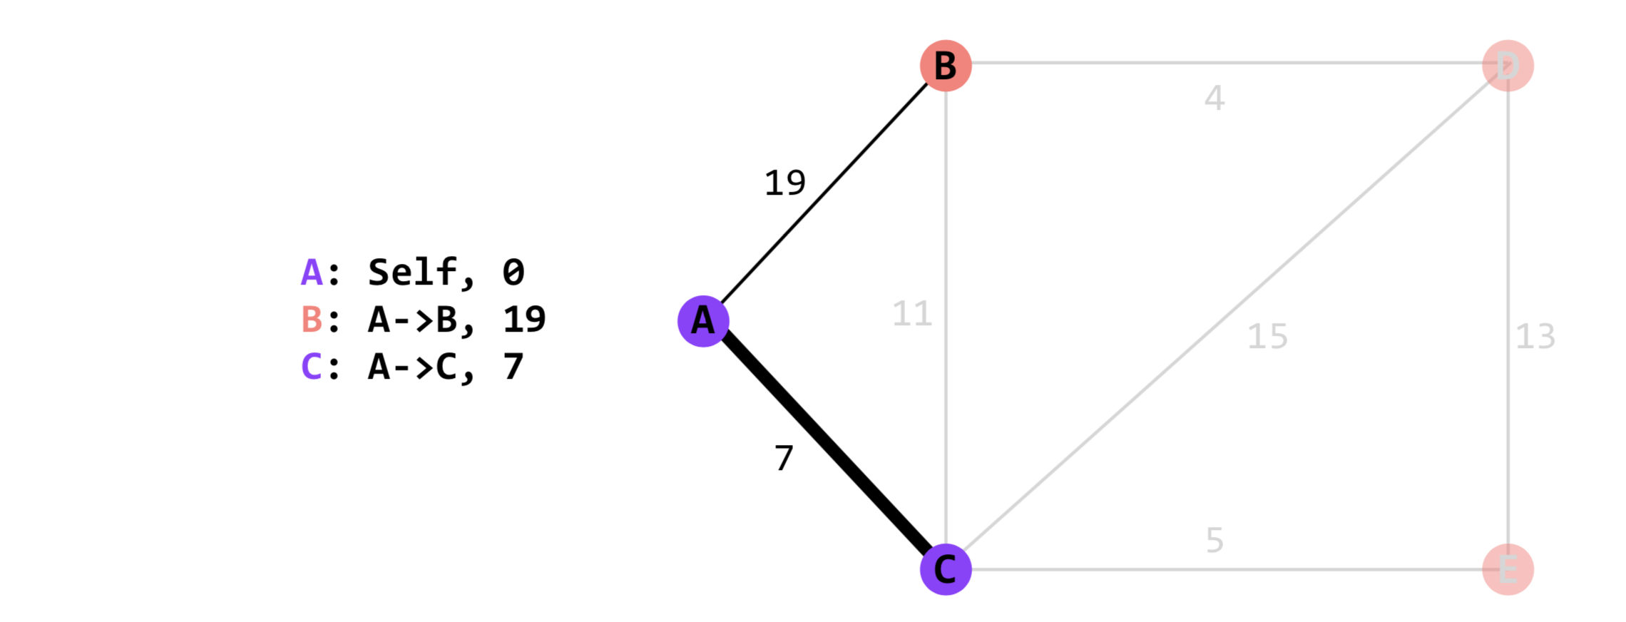
Link-state Routing

Slide 45
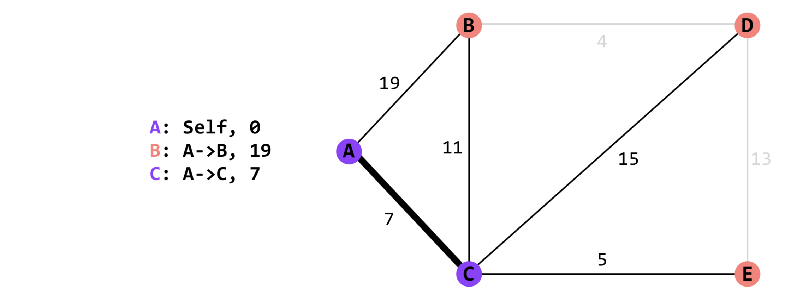
Link-state Routing

Slide 46
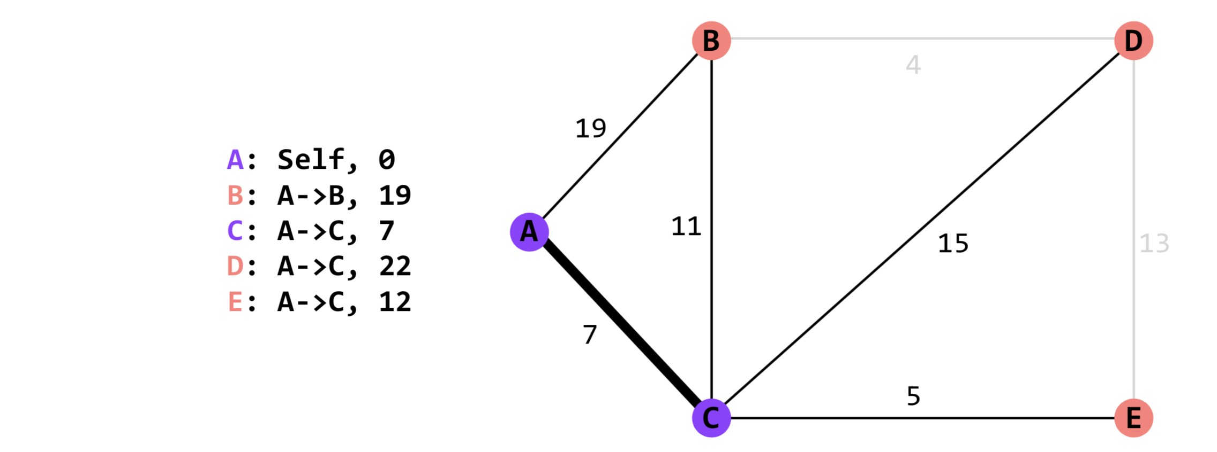
Link-state Routing

Slide 47
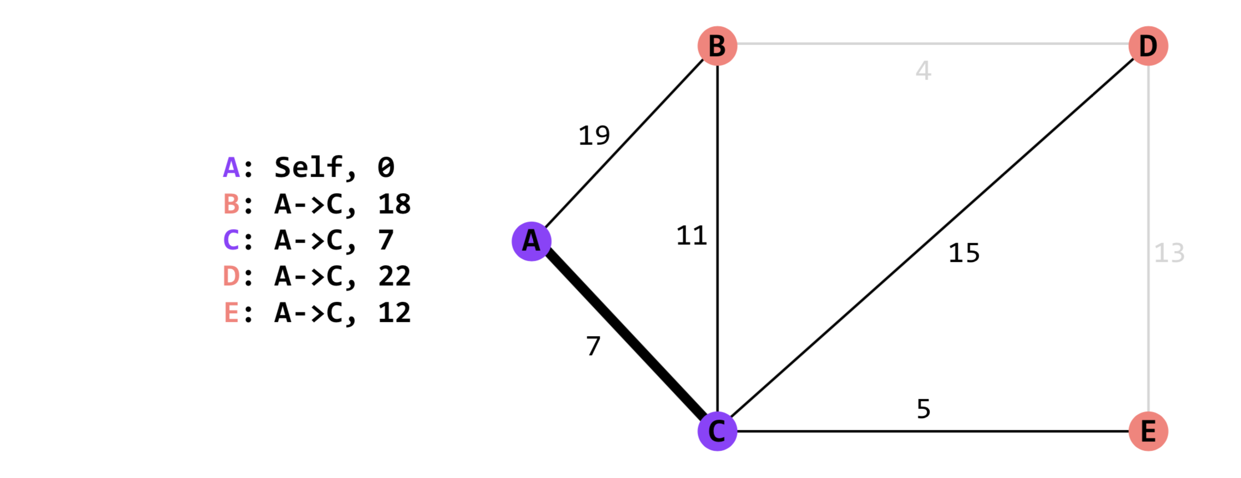
Link-state Routing
Through C is faster

Slide 48
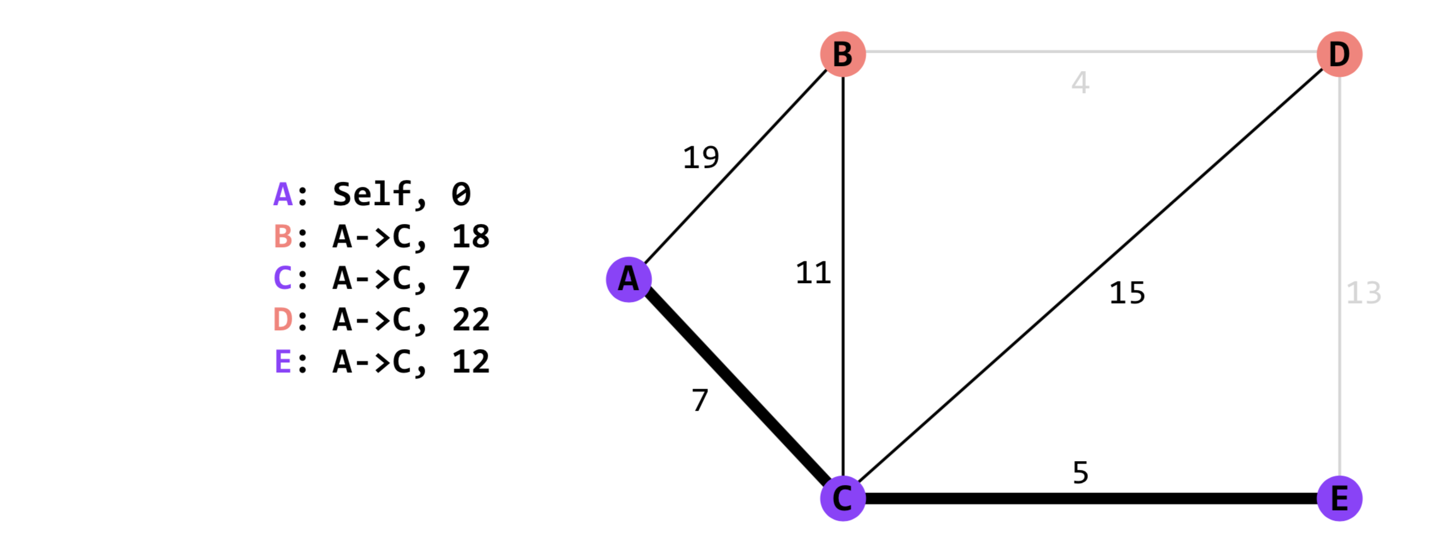
Link-state Routing

Slide 49
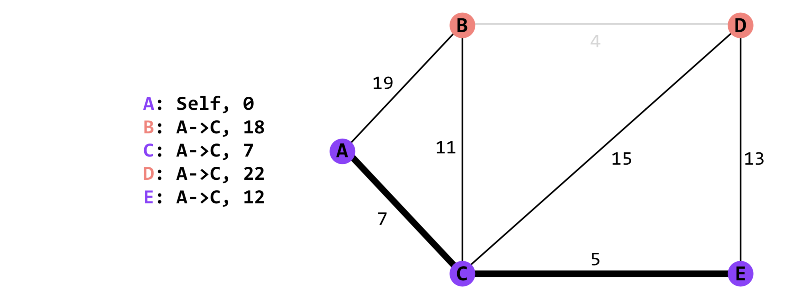
Link-state Routing

Slide 50
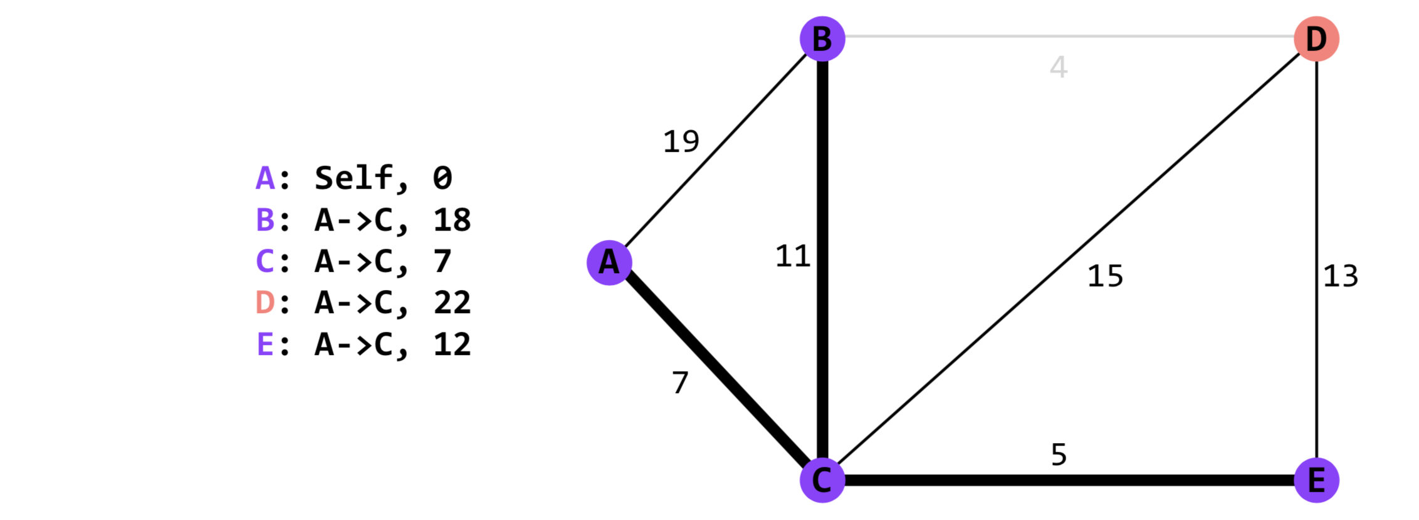
Link-state Routing

Slide 51
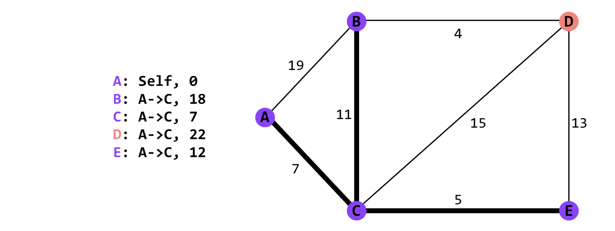
Link-state Routing

Slide 52
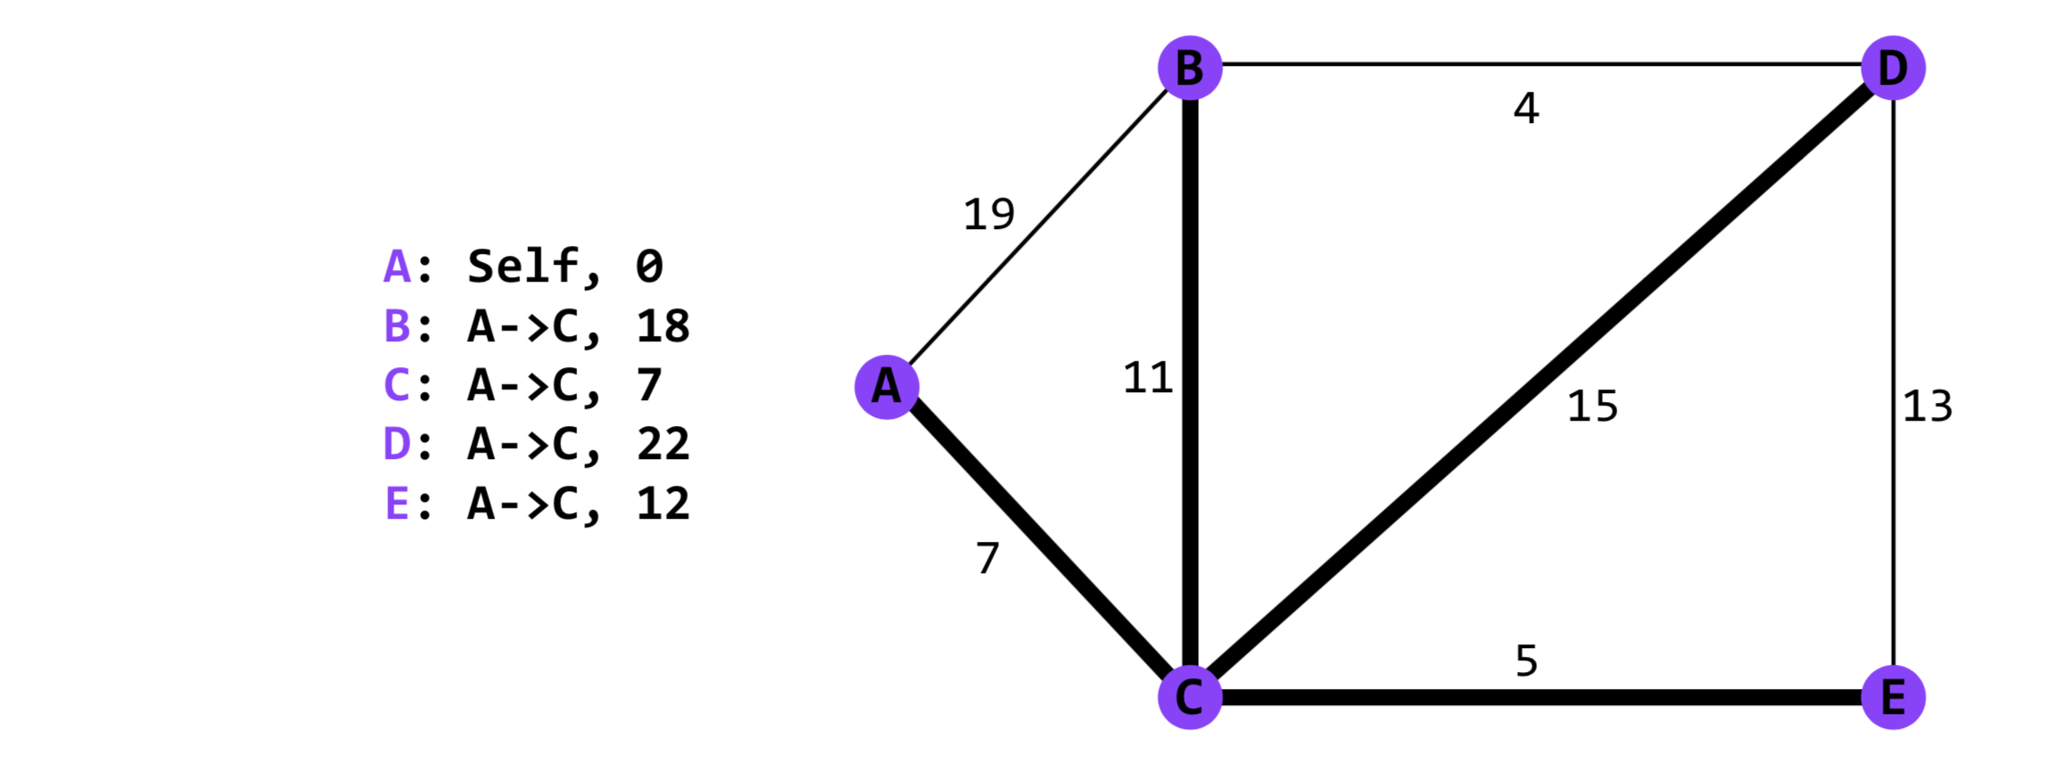
Link-state Routing

Slide 53
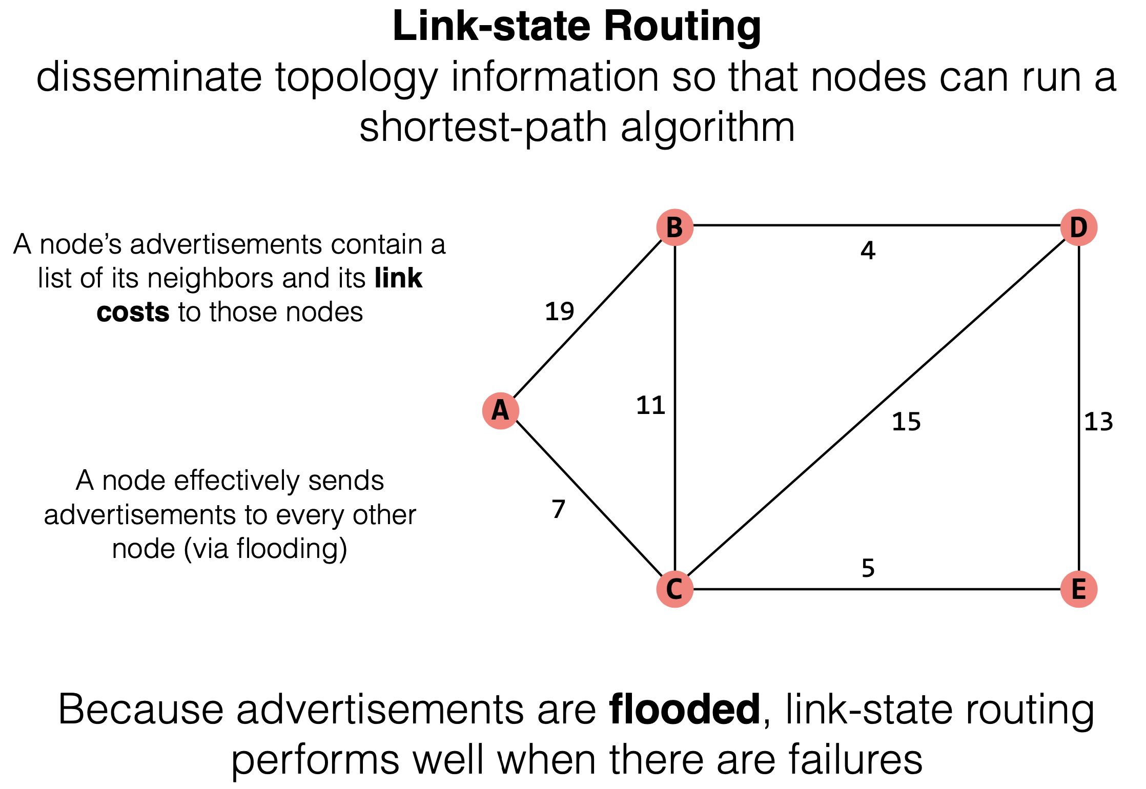

Slide 54
Distance-vector Routing
Link-state Routing
  Disseminate topology information so that nodes can run a shortest-path algorithm
Distance-vector Routing
  Disseminate information about the current costs to each node, rather than the actual topology

Slide 55
Distance-vector Routing
In link-state, nodes calculate full shortest paths. They really only need the route (first-hop) to a destination
Advertisement format: Each node's advertisement is a lists of all the nodes it knows about, and its current costs to those nodes
  Initially, this advertisement is just [(self, 0)].
Nodes who receive an advertisement: Node X's advertisement will be received only by its neighbors
Integrate step: When node X receives an advertisement from its neighbor Y, this advertisement will be a list of [(dst, cost)] pairs. Each cost represents Y's cost to dst

Slide 56
Distance-vector Routing
For each (dst, cost) in the advertisement, X needs to check for two things:
  If X is already using Y to get to dst, update the cost information (remember, costs can change!)
  If X is not already using Y to get to dst, see if Y could provide a better path; if so, update the routing and cost information

Slide 57
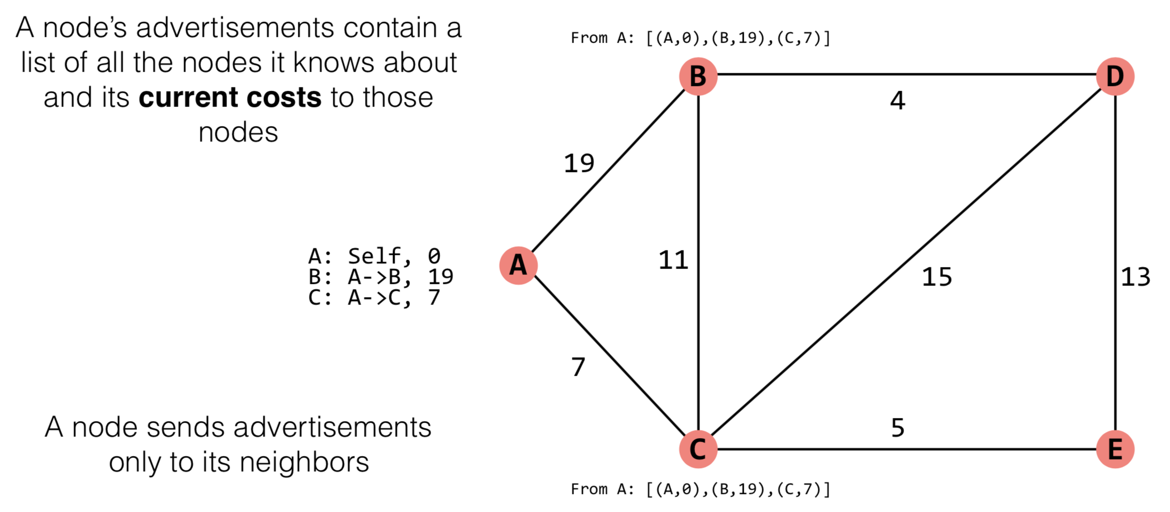
Distance-vector Routing
Notes:
与link-state不同的是，current cost并不关心拓扑信息，而是已经包含了一部分计算的结果

Slide 58
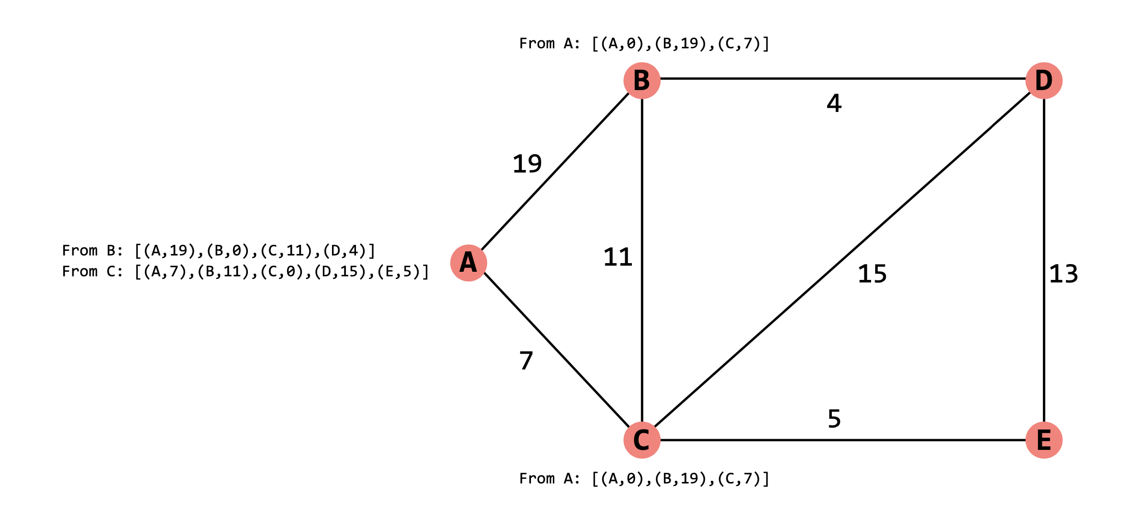
Distance-vector Routing

Slide 59
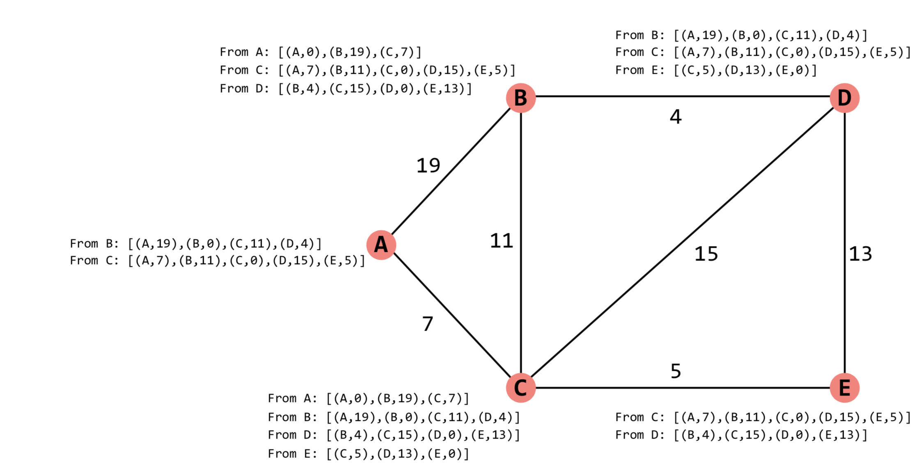
Distance-vector Routing

Slide 60
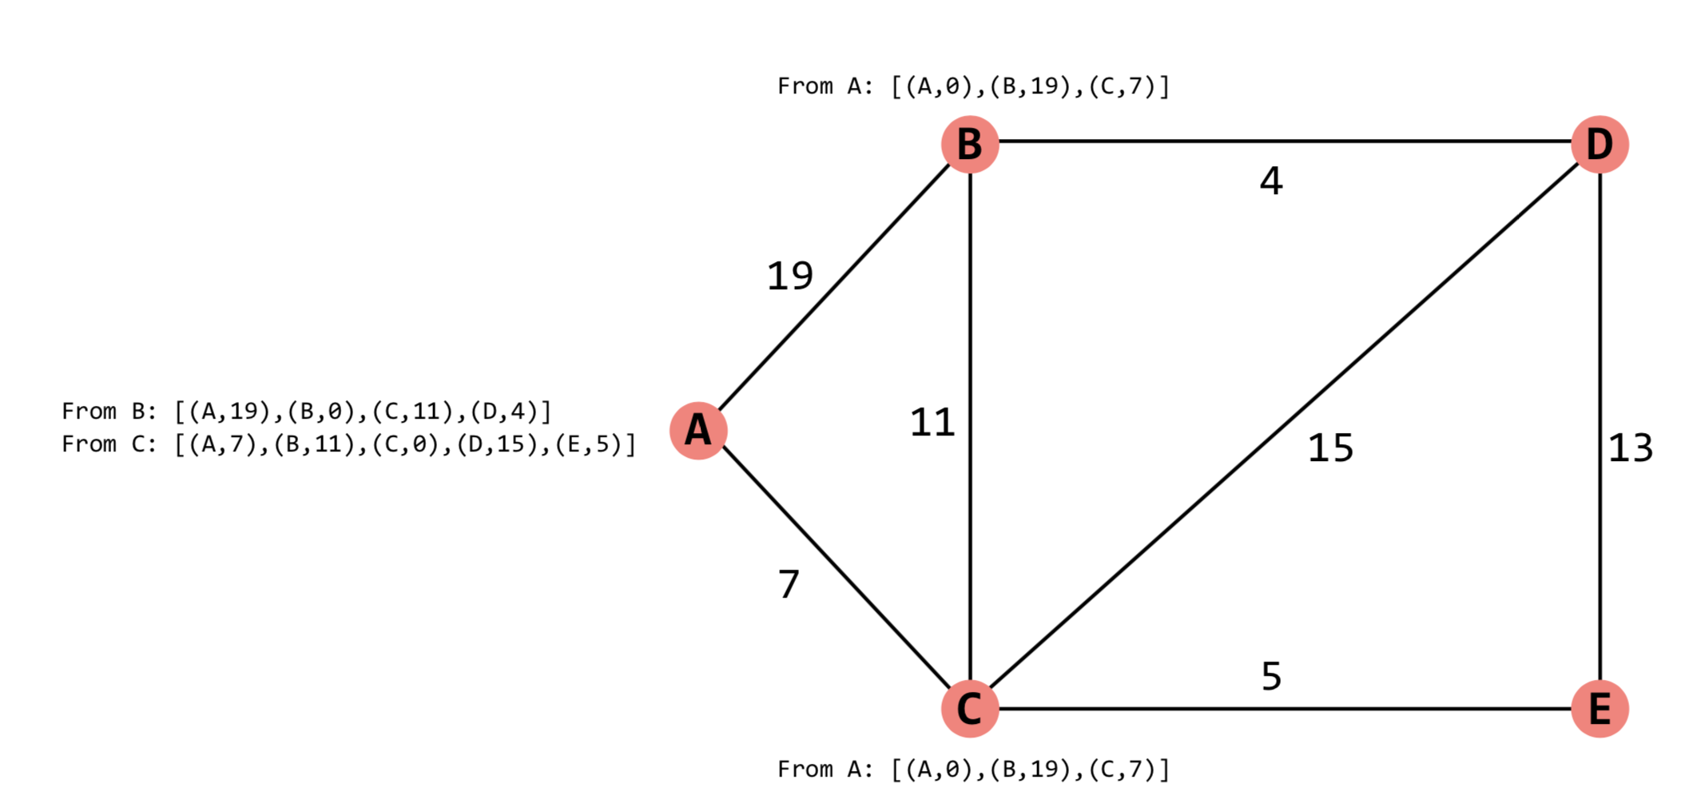
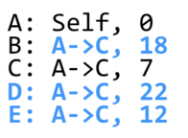
Distance-vector Routing

Slide 61
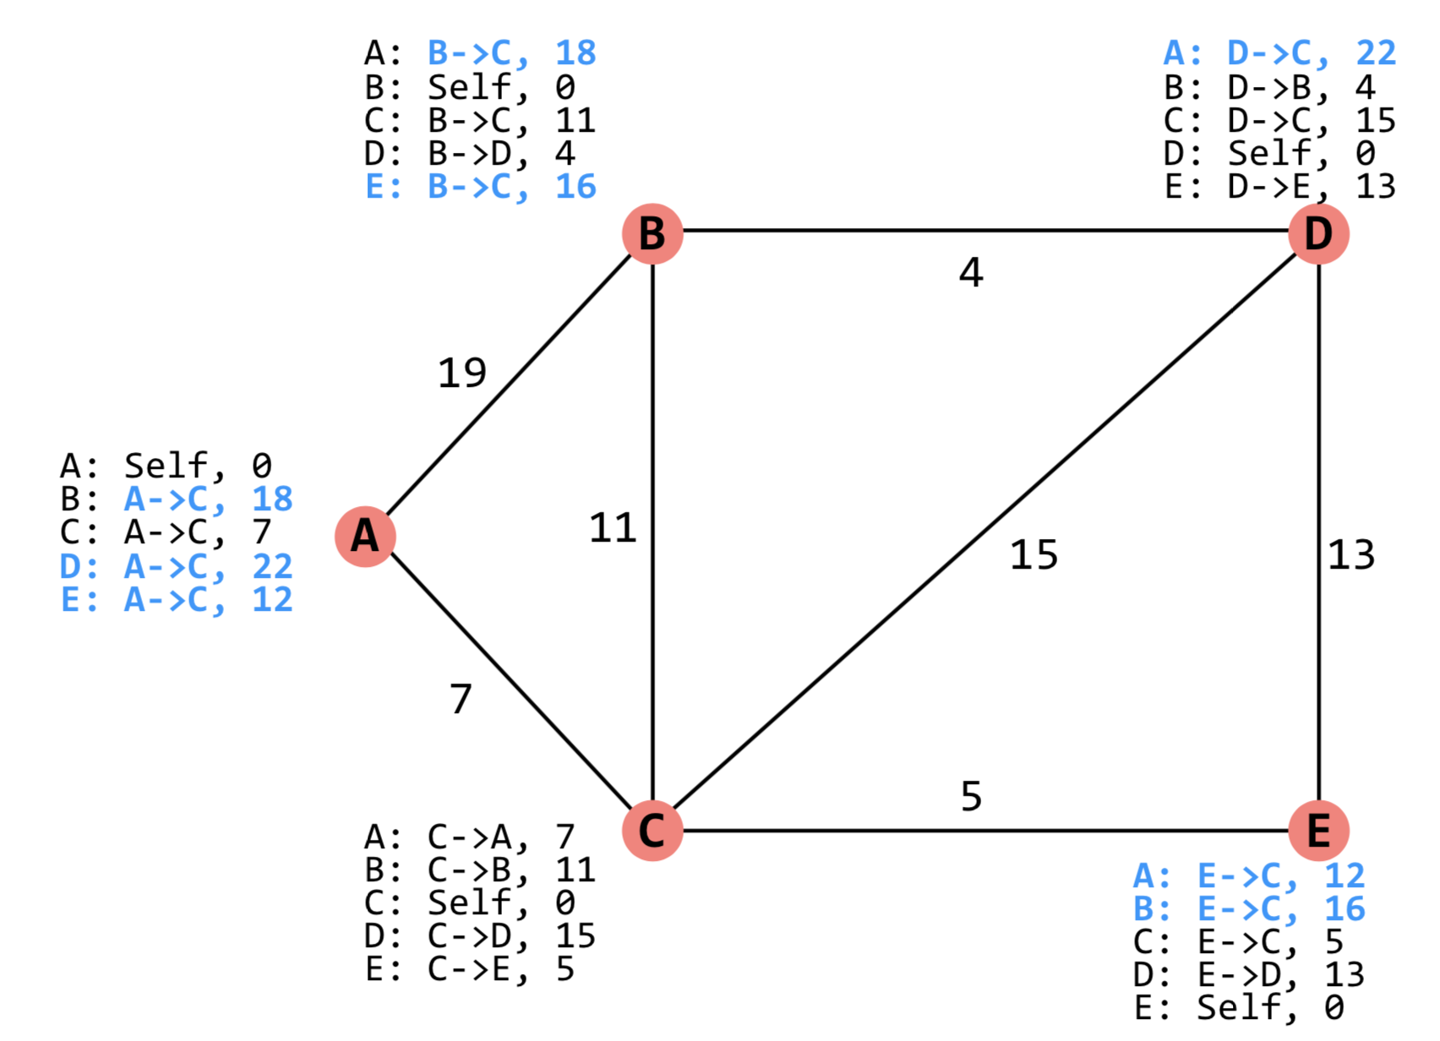
Distance-vector Routing

Slide 62
Problem of INFINITY
When a node A has no route to destination B, it will advertise, a cost of INFINITY to B.
  A cost of INFINITY B is interpreted as there being no route to B.
  So INFINITY must be larger than the longest path in the network
But because the order in which advertisements are sent matters, sometimes nodes can incorrectly think there's a route when there isn't one.
This can last for up to INFINITY steps (Infinity is usually 16 or 32)

Slide 63
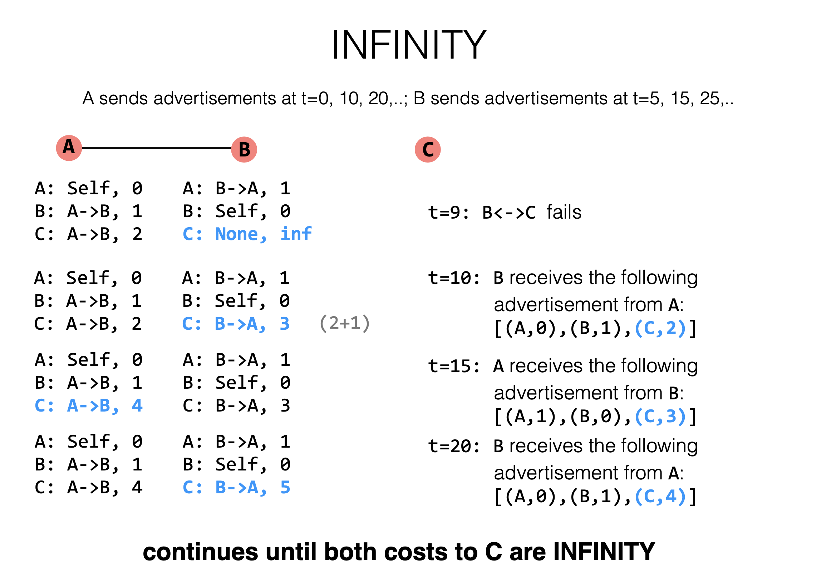
Previous was C: B->, 1

Slide 64
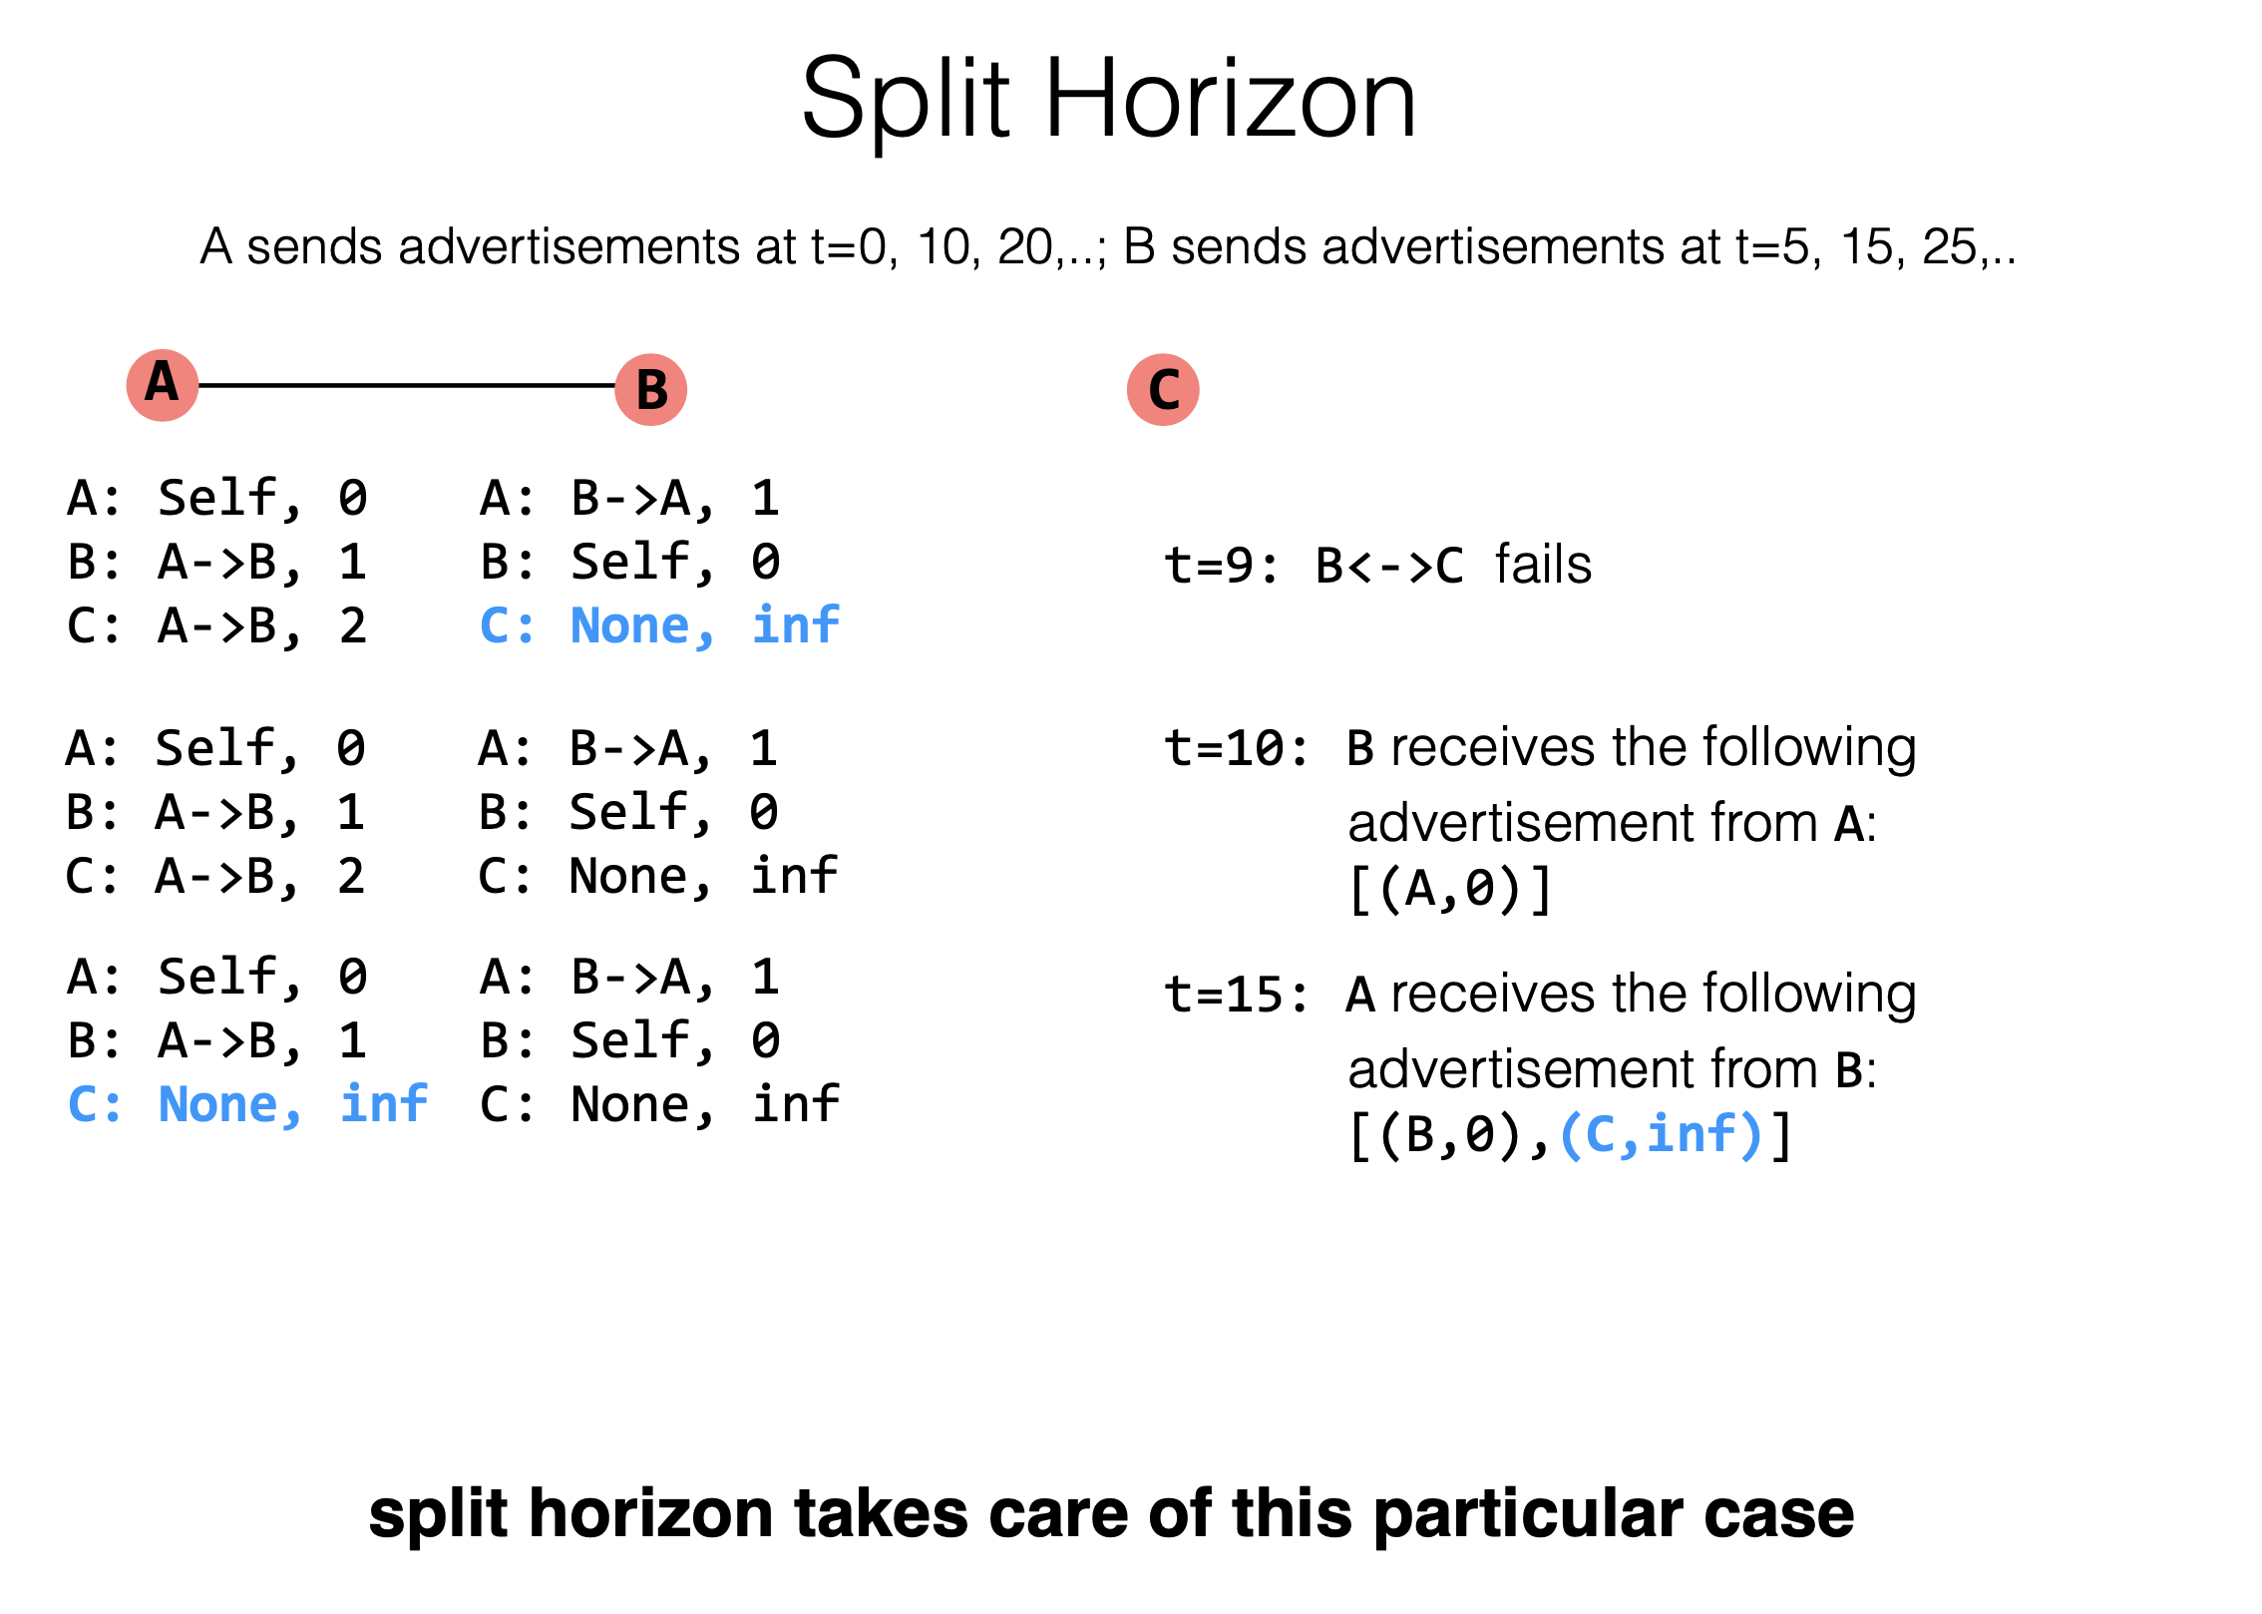
Don’t send advertisements about a route to the node providing the route

Slide 65
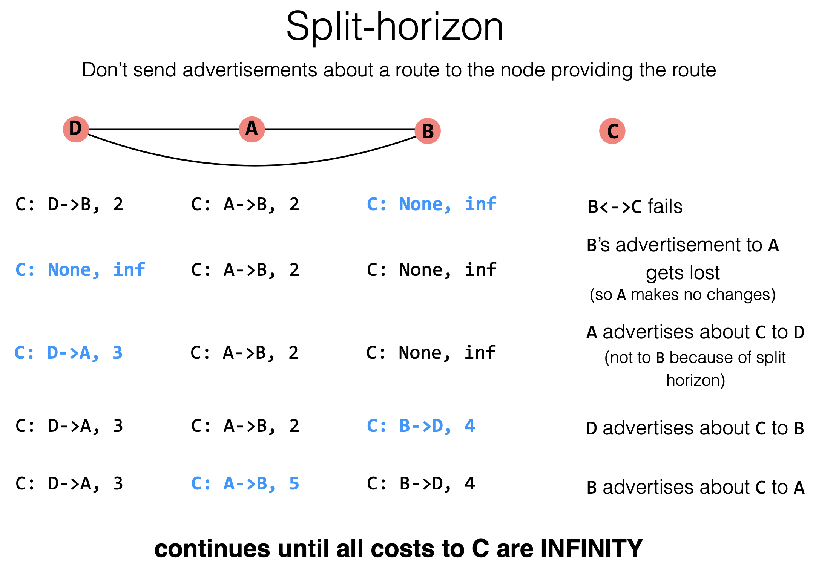

Slide 66
Both Cannot Scale
Link-state routing
  Nice, easy to reason about failures, but overhead prevents it from scaling. In practice, good for SJTU-sized networks
Distance-vector routing
  significantly less overhead, but harder to reason about failures
  In practice, good for very small networks (where we can reason about properties of routing loops)

Slide 67
Routing: Scale to Internet

Slide 68
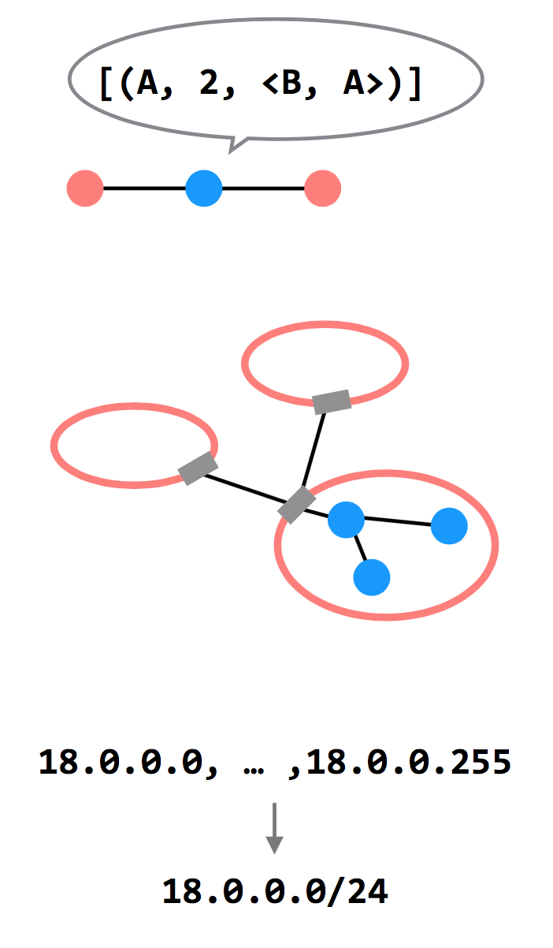
3 Ways to Scale
Path-vector Routing
  Advertisements include the path, to better
  detect routing loops
Hierarchy of Routing
  Route between regions, and then within a
  region
Topological Addressing
  Assign addresses in contiguous blocks to
  make advertisements smaller

Slide 69
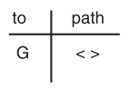
Path Vector Exchange
Each participant maintains a path vector
  A complete path to some destination
  E.g., zero-length path to itself
  Gradually learns about other paths
  Construct a new forwarding table from its new path vector
Algorithm
  Advertising
  Path selection

Slide 70
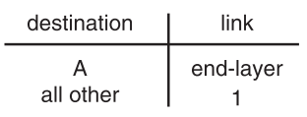
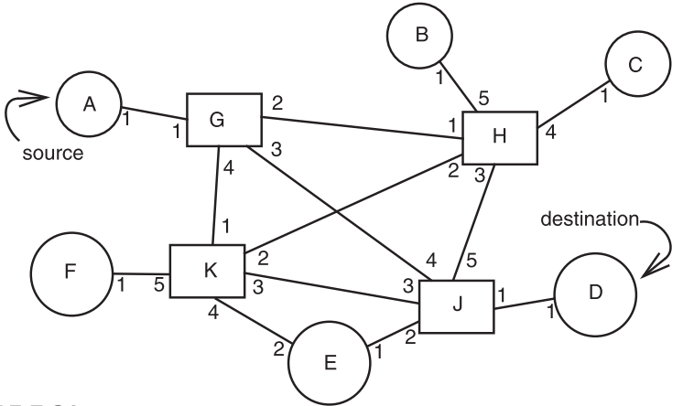
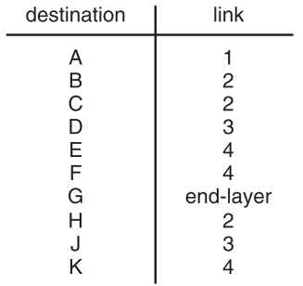
Path Vector Exchange
A
G
Need coordination to ensure no loop

Slide 71
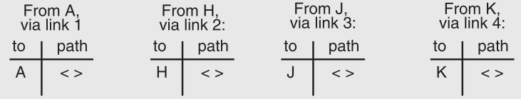
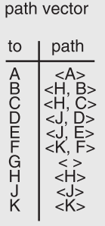
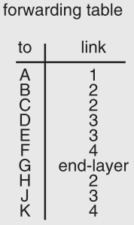
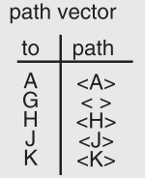
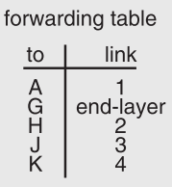
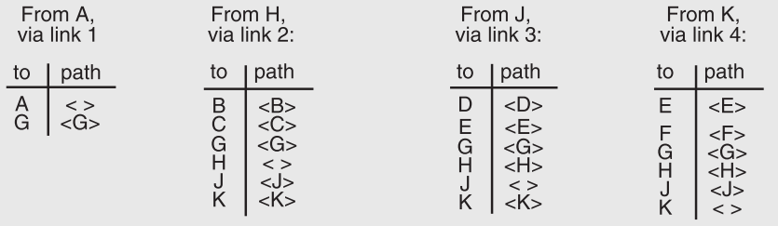

Slide 72
Path Vector Exchange
Better for scaling
  Like Distance-Vector, but include the full path in the routing advertisements
  Overhead increases (advertises are larger), but convergence time decreases (avoid counting to infinity)
  Overhead is still lower than Link-State

Slide 73
Question on Path Vector
How do we avoid permanent loops?
  When a node updates its paths, it never accepts a path that has itself
What happens when a node hears multiple paths to the same destination?
  It picks the better path
What happens if the graph changes?
  Algorithm deals well with new links
  To deal with links that go down, each router should discard any path that a neighbor stops advertising

Slide 74
Hierarchical Address Assignment & Routing
Two problems of the path vector implementation
  Every attachment point must have a unique address
  The path vector grows in size with the number of attachment points
Hierarchy for better scalability
  Two parts of network address: region & station, e.g., "11,75"
  Regions correspond to the set of closely-connected entities
  E.g., region-11 has only 1 entry in other region routers' table

Slide 75
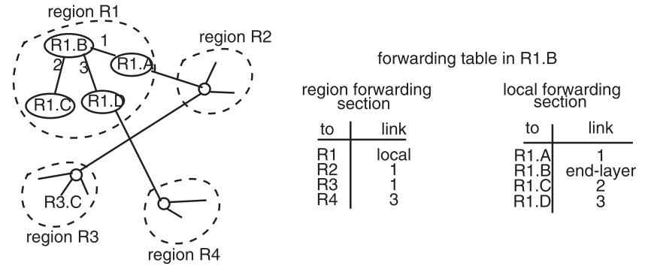
Hierarchical Address Assignment & Routing
Region is also as known as AS: Autonomous System

Slide 76
Hierarchical Address Assignment & Routing
Problems introduced by hierarchy: more complex
  Binding address with location
    Has to change address after changing location
  Paths may no longer be the shortest possible
    Algorithm has less detailed information
More about hierarchy
  Can extend to more levels
  Different places can have different levels

Slide 77
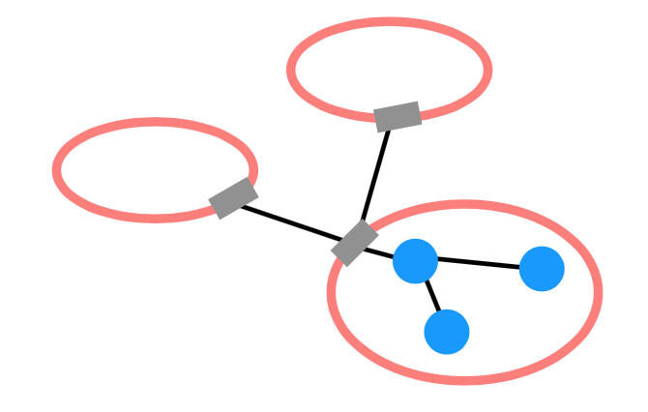
Routing Hierarchy
Across Region
  Use one routing protocol to route across regions, and a
  different protocol to route within regions
  Implies that there are devices on the edge of each region that can "translate" between or "speak" both protocols
BGP is the path-vector protocol used across regions
  Border Gateway Protocol

Slide 78
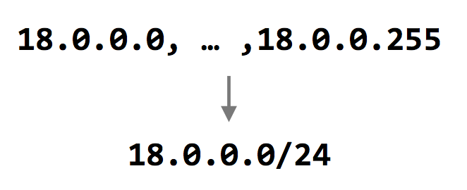
Topological Addressing
Further reduce the routing table
  Despite being between regions, BGP still routes to IP addresses (e.g., to 18.0.0.1, not to region-3 )
  Addresses are given to regions in contiguous blocks, so that they can be specified succinctly via a particular notation ("CIDR" notation)
    CIDR: Classless Inter Domain Routing
  Keeps advertisements small
CIDR Notation

